Slide 1
Data Communication and Computer Network
BSc.CSIT 1st sem

Slide 2
Syllabus
Introduction
Importance of Networking
Data Transmission Mode
Data Transmission Media
Data Transmission and Data Networking
Computer Network
Network types
Network topology
Communication protocol
Network Devices
Wireless Networking

Slide 3
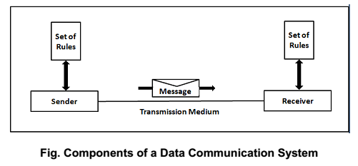
Introduction: Data Communication
A communication system is a set of processes, technologies, and channels that allow individuals or groups to exchange information.
The basic components of a communication system include a sender, a message, a channel, a receiver, and feedback.
Communication systems can be analog or digital and can be used for various purposes such as interpersonal communication, mass communication, or machine-to-machine communication.

Slide 4
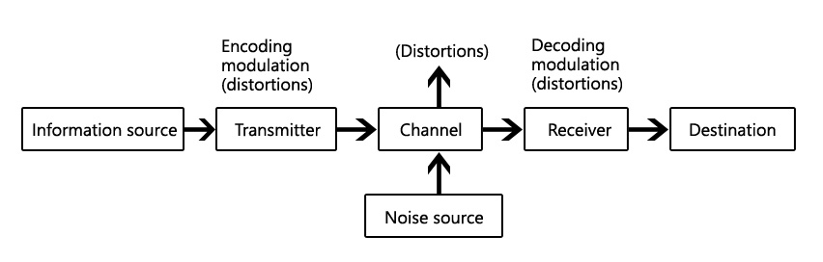
Block diagram of Communication system

Slide 5
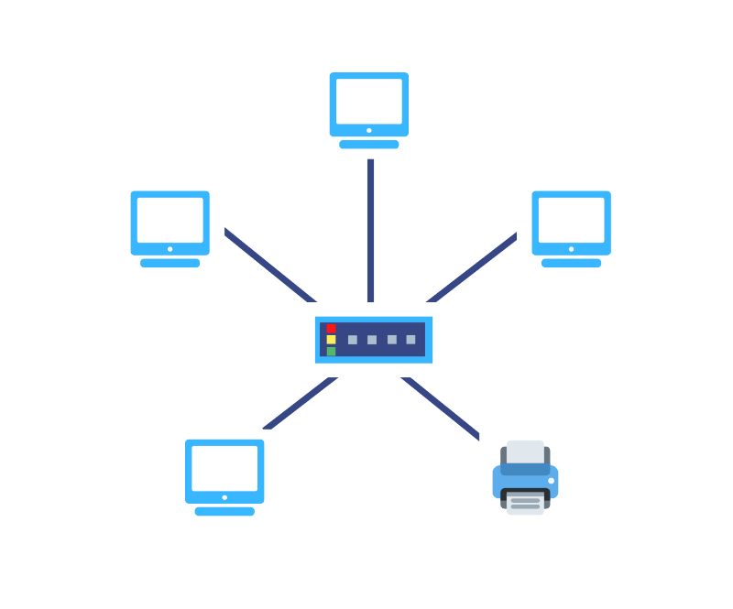
Introduction: Computer Network
Computer network is group of computers connected to each other through some medium in order to share data/information and controls.

Slide 6
Importance of Computer Network
Sharing of Resources
Information Sharing
Centralize administration and support
Faster and cheaper communication
Backup and Recovery
Disadvantages of networking
Security of data
Need special technical knowledge

Slide 7
Mode of Communication/Transmission media
In a network communication system, there are several modes of communication, including:
Simplex communication: This is a one-way communication mode where data is transmitted in only one direction. An example of this is a television broadcast.
Half-duplex communication: This is a two-way communication mode where data can be transmitted in both directions, but not at the same time. An example of this is a walkie-talkie.
Full-duplex communication: This is a two-way communication mode where data can be transmitted in both directions simultaneously. An example of this is a telephone call.

Slide 8
Types of Data Transmission Media
Transmission media refers to the physical means by which data is transmitted from one device to another in a communication system.
Data is transmitted through the electromagnetic signals or wave signal or light signal.
Transmission media is of two types are wired media and wireless media. In wired media, medium characteristics are more important whereas, in wireless media, signal characteristics are more important.
Different transmission media have different properties such as bandwidth, delay, cost and ease of installation and maintenance.

Slide 9
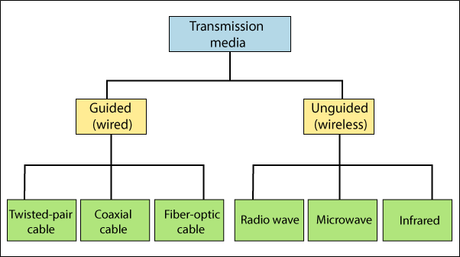
Types of Transmission media
Guided medium: It used metal wire or glass to transmit data in form of electromagnetic signals or light signals
Unguided medium : It uses air as medium to transmit data in form of radio signals

Slide 10
Twisted pair cable
Twisted Pair Cable is a type of copper cable used in communication systems. It is composed of two insulated copper wires that are twisted together in a spiral pattern. The twisting helps to reduce the amount of electromagnetic interference (EMI) and radio frequency interference (RFI) that the cable picks up.
The connector used in twisted pair cable is RJ connector.
There are two types of twisted pair cable: unshielded twisted pair (UTP) and shielded twisted pair (STP). UTP cable is more commonly used for networking applications because it is lightweight, flexible, and less expensive than STP cable.
Twisted pair cable is commonly used for Ethernet networks and telephone lines. It is a reliable and cost-effective transmission medium that can support both data and voice communication.

Slide 11
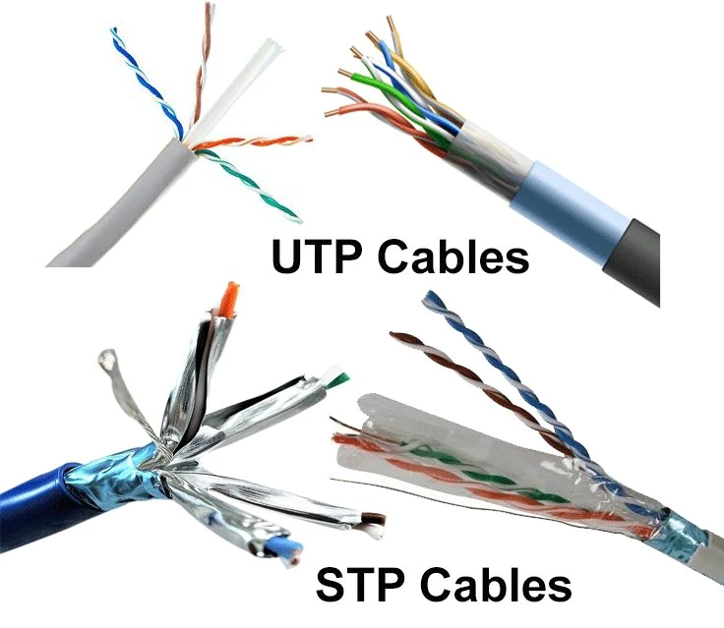
Twisted Pair cable

Slide 12
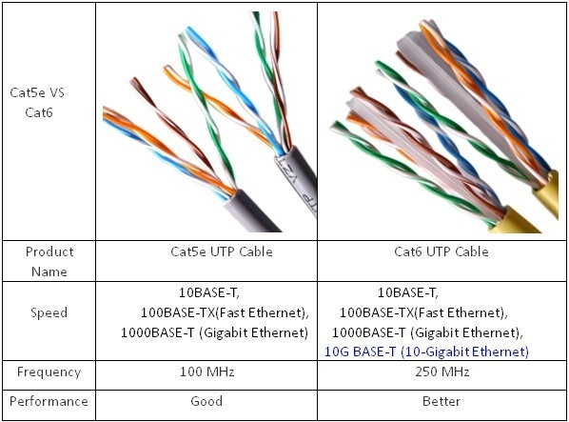
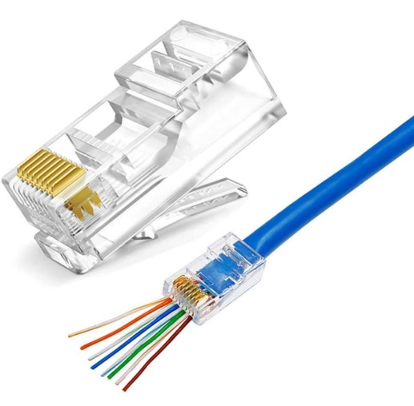
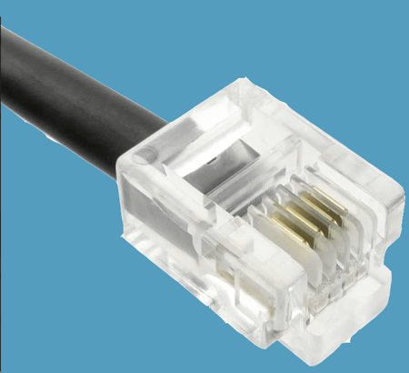
Twisted Pair cable
RJ 45 connector
RJ 11 connector

Slide 13
Coaxial cable
Coaxial cable, also known as coax cable, is a type of cable used in communication systems. It consists of a copper core that carries the signal, surrounded by plastic insulation and foil shield. Over them a metal (closely woven braided mesh) encased and finally another protective plastic casing
The metal shield helps to reduce electromagnetic interference (EMI) and radio frequency interference (RFI) that can affect the signal quality.
Coaxial cable is commonly used for cable television (CATV) and broadband internet. It is also used in professional video and audio applications, such as in studios and broadcast facilities.
One of the advantages of coaxial cable is its ability to transmit high-frequency signals over long distances with minimal signal loss.

Slide 14

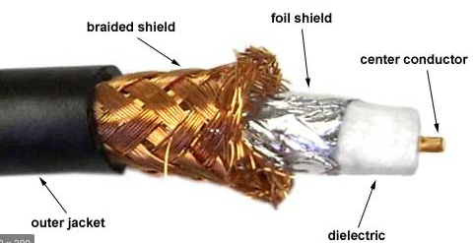
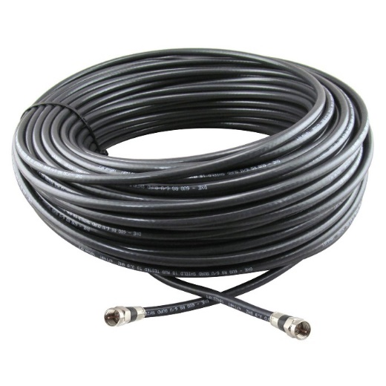
Coaxial cable
BNC connector

Slide 15
Fiber Optic Cable
Fiber optic cable, also known as optical fiber cable, is a type of cable used in communication systems that transmits data in form of light.
It consists of a glass or plastic core that carries the light, surrounded by cladding that helps to keep the light within the core. The core and cladding are covered by a protective outer layer called the buffer.
The refractive index of cladding less than of core and the light is passed in core in the angle so that total internal reflection is realized.
Fiber optic cable is known for its high bandwidth, fast data transmission speeds, and resistance to interference since it uses light signal .
It is widely used in high-speed data transmission applications, such as in the internet backbone, long-distance telecommunications.

Slide 16
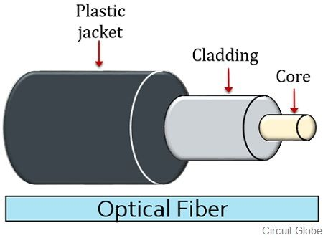
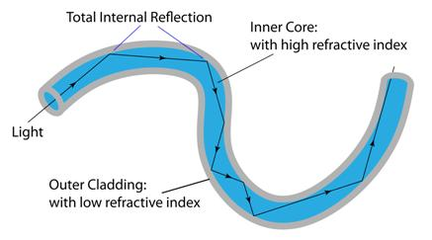
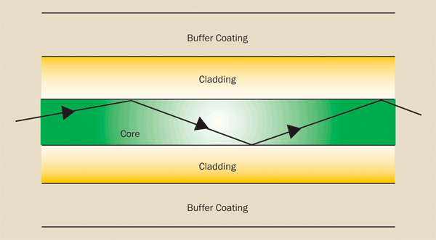
Fiber Optic Cable

Slide 17
Unguided Media
Unguided or wireless communication refers to the transmission of information or data without the use of physical connections or wires.
Instead, wireless communication relies on electromagnetic waves or other forms of energy to transmit data from one device to another through air.
This type of communication provides greater mobility and freedom for users as they are not tied to a physical connection.

Slide 18
Types of Unguided media
Radio Waves, Microwave System ,Communication satellite , Infrared waves

Slide 19
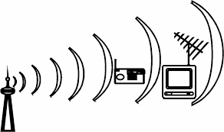
Radio waves communication
Electromagnetic waves ranging in frequencies between 3KHz and 1GHz are normally called radio waves.
Radio waves are easy to generate, can travel long distance and can penetrate the obstacle, so are widely used for communication both indoors and outdoors.
It transmits in signal in omnidirectional.
Single sender and send signal to multiple receiving antenna.
Disadvantage is radio waves can be interfered by sending another signal on same frequency.
It is used in AM,FM radio, television, cordless phone ,walkie talkie

Slide 20
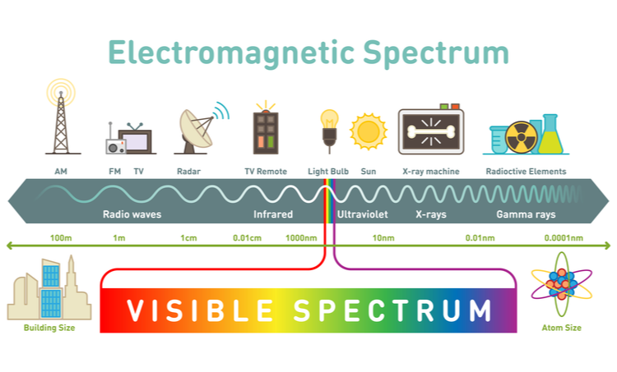
Electromagnetic Spectrum

Slide 21
Microwave station
Electromagnetic wave having frequencies between 1 and 300GHz are called Microwaves.
Microwave system uses high frequency(high speed) radio signals to transmit data through space.
At microwaves frequencies the electromagnetic waves cannot bend and pass obstacles like hill. So, it is necessary that microwaves transmission be in the line of sight
Line of sight communication means that there must be an unblocked direct line between the workstations and transceiver. The line of sight due to earths curvature is only 50Kms
Microwave propagates in only one direction at a time. Hence, two frequencies are required for two way communication.
Microwave signal loses its strength with distance. So repeaters must be place in interval of 25-30 km
Microwave relay stations are placed generally on top of hill or tall buildings.

Slide 22
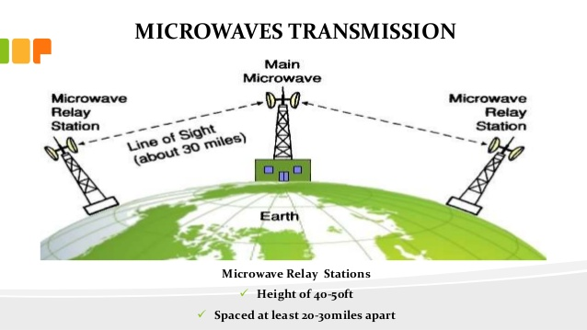
Microwave station

Slide 23
Satellite Communication
A Artificial satellite is an artificial object that is projected in space to orbit the Earth or another celestial body. Satellites are used for a variety of purposes, including communication, navigation, meteorology, and scientific research.
Communication satellites are used to transmit signals from one location on the Earth to another, and are an important component of the global communication network. Navigation satellites are used to provide precise positional information to enable navigation systems, such as GPS.
In satellite communication, the terms "uplink" and "downlink" refer to the transmission of signals between the Earth and a satellite. The uplink refers to the transmission of signals from the Earth to the satellite, while the downlink refers to the transmission of signals from the satellite to the Earth.

Slide 24
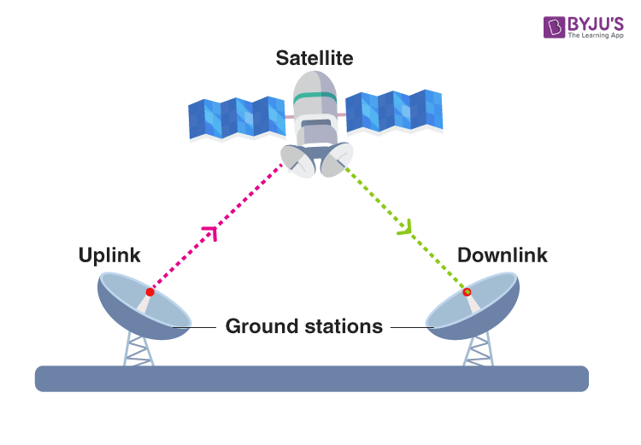
Satellite

Slide 25
Questions:
What is Communication System? What are the types of Transmission media?
Differentiate between Guided and Unguided Transmission media.

Slide 26
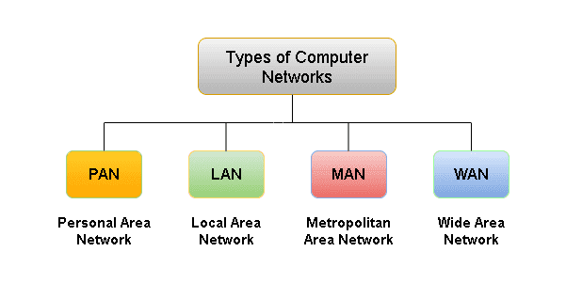
Types of Computer Network

Slide 27
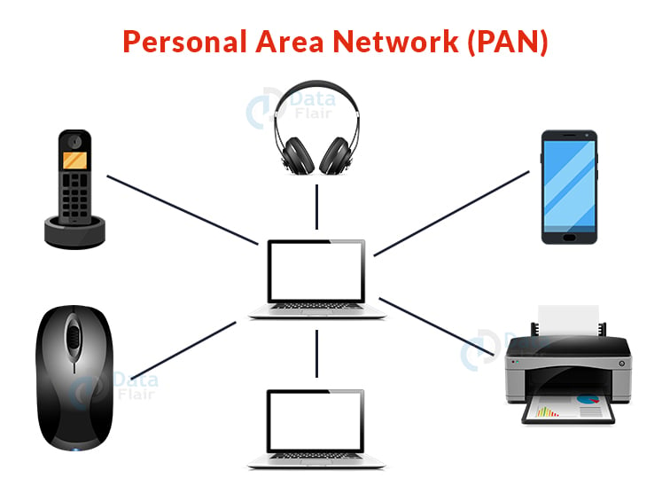
Personal Area Network (PAN)
A Personal Area Network (PAN) is a type of computer network that is used to connect devices that are close to an individual, such as a smartphone, tablet, or laptop. PANs are typically created using wireless communication technologies, such as Bluetooth or NFC (Near Field Communication).
The main purpose of a PAN is to allow devices to exchange data and share resources, such as printers or files, with each other without the need for a wired connection. PANs are also used to connect wearable devices, such as smartwatches or fitness trackers, to other devices, such as smartphones.

Slide 28
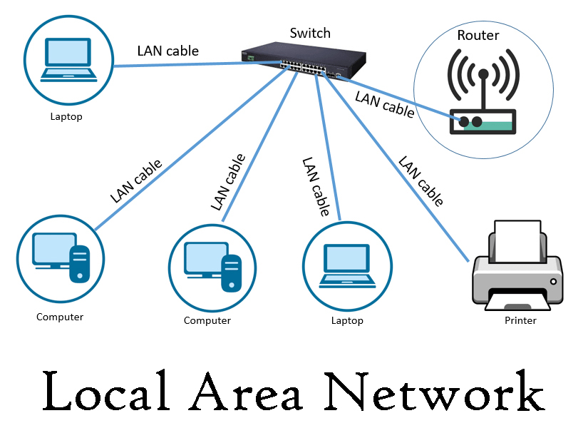
Local Area Network (LAN)
A Local Area Network (LAN) is a type of computer network that covers a small geographic area, such as a home, office, or a building.
A LAN network is typically used to connect computers and other devices, such as printers, in a small area to allow them to share resources and exchange data.
In a LAN network, computers are connected to each other using cables, such as Ethernet cables, or through wireless communication.
The main advantage of a LAN network is that it provides high-speed communication and allows for the sharing of resources, such as printers and files, among all connected devices.

Slide 29
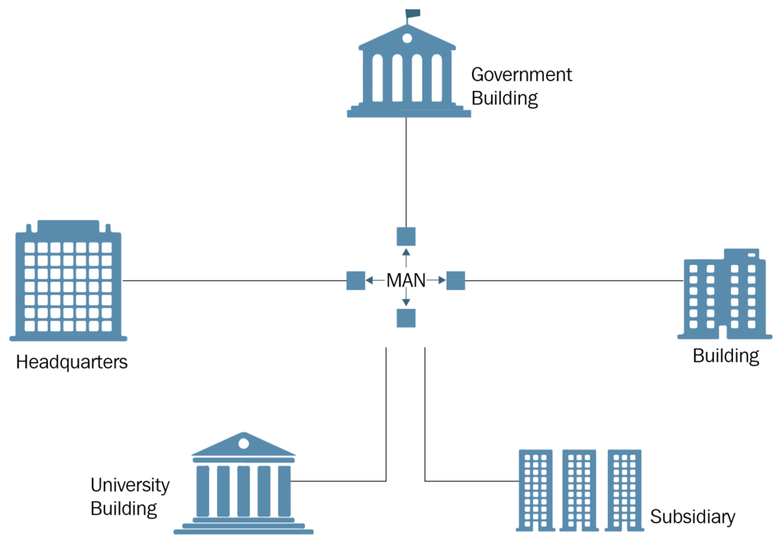
Metropolitan Area Network (MAN)
A Metropolitan Area Network (MAN) is a type of computer network that covers a city or a metropolitan area. It is larger than a Local Area Network (LAN) but smaller than a Wide Area Network (WAN).
MANs are typically used to connect multiple LANs within a metropolitan area to provide high-speed communication and resource sharing among a large number of users.

Slide 30
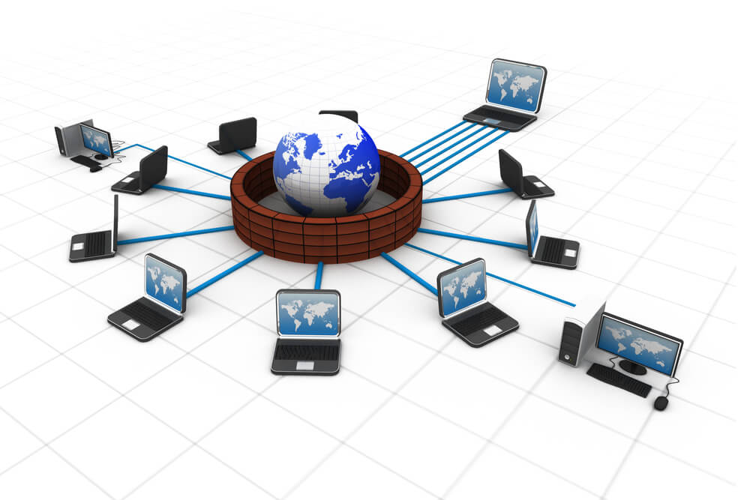
Wide Area Network (WAN)
A Wide Area Network (WAN) is a type of computer network that covers a large geographic area, such as a country or the entire world.
WANs are used to connect multiple local area networks (LANs) and metropolitan area networks (MANs) to provide communication and resource sharing among a large number of users and devices.
WANs are typically implemented using long-distance communication technologies, such as leased lines, satellite communication, or public communication networks, such as the internet.
They are designed to support large numbers of users and devices and can cover distances that span thousands of miles.

Slide 31
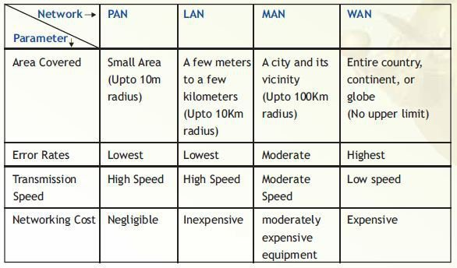
Differentiate between types of networks:

Slide 32
Question 2:
Differentiate between PAN, LAN, MAN and WAN.

Slide 33
Network Topology
Computer network topology is the way various components of a network (like nodes, links, peripherals, etc) are arranged.
Network topologies define the layout, virtual shape or structure of network, not only physically but also logically.
The way in which different systems and nodes are connected and communicate with each other is determined by topology of the network.

Slide 34
Topology can be physical or logical
Physical Topology is the physical layout of nodes, workstations and cables in the network.
Logical topology is the way information flows between different components.

Slide 35
Types of Physical Network Topologies
Bus Topology
Star Topology
Ring Topology
Mesh Topology
Tree Topology
Hybrid Topology

Slide 36
Bus Topology
In the bus topology, the computers are connected through a common communication media. A special type of central wire is used as communication media.
This central wire is called Bus. The computer are attached through the bus the ends of the bus are closed with the terminator .The terminators are used to absorb signals.

Slide 37
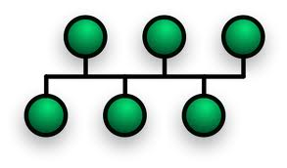
Bus Topology

Slide 38
Advantages of Bus Topology
Easy to install and configure
Inexpensive
Easily extended

Slide 39
Disadvantages of Bus Topology
Performance decreases
Weak signals
Difficult troubleshooting

Slide 40
Star Topology
The star topology uses a separate cable for each work station as shown in fig. The cable connects the work station to a central device typically a HUB.
The configuration provides a more reliable network that is easily expanded. With star there is no central point of failure in the cable. If there is a problem with the cable only the station connected to that cable is a effected to add more work stations simply connect another HUB.

Slide 41

Star Topology

Slide 42
Advantages of Star Topology
Easily expended and modified
Easy to troubleshoot
Multiple cable types supported by hub

Slide 43
Disadvantages of Star Topology
If hub fails then entire network will fail
Require more cables
May require a device to rebroadcast signals across the network

Slide 44
Ring Topology
Every computer is connected to the next computer in the ring and each transmits what it receives from the previous computer. The messages flow around the ring in one direction.
Some ring network do ring token passing. A short message called token (memory area)is passed around a ring until a computer wishes to send information to other computers.
That computer modifies token, adds an electronic address and data and send it around the ring. Each computer in sequence receives the token and next computer until either the electronic address matches the address of a computer.
Or the token return to its origin .The receiving computer returns a message to the sender indicating that message has been received.

Slide 45
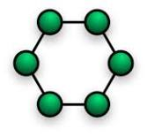
Ring Topology

Slide 46
Advantages
It provides an orderly network in which every device has access to the token and can transmit.
It performs well under a heavy load.

Slide 47
Disadvantages
Failure of one computer can effect the whole network .
Difficult to troubleshoot.
Change mode with adding or removing a device effect the entire network.

Slide 48
Mesh Topology
A mesh network or mesh topology uses separate cable to connect each device to every other device on the network, providing a straight communication path.
For sending messages, check the cable connected into two devices. A message is send directly from sender to receiver because each one has individual and separate connection.

Slide 49
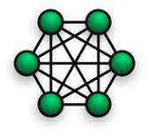
Mesh Topology

Slide 50
Advantages
Enhance for error tolerance provided by redundant links.
Easy to troubleshoot.

Slide 51
Disadvantages
Difficult to install and maintain.
Expensive.

Slide 52
Tree Topology
The type of network topology in which a central 'root' node (the top level of the hierarchy) is connected to one or more other nodes that are one level lower in the hierarchy (i.e., the second level) with a point-to-point link between each of the second level nodes and the top level central 'root' node, while each of the second level nodes that are connected to the top level central 'root' node will also have one or more other nodes that are one level lower in the hierarchy (i.e., the third level) connected to it, also with a point-to-point link, the top level central 'root' node being the only node that has no other node above it in the hierarchy (The hierarchy of the tree is symmetrical.)
Each node in the network having a specific fixed number, of nodes connected to it at the next lower level in the hierarchy, the number, being referred to as the 'branching factor' of the hierarchical tree.

Slide 53
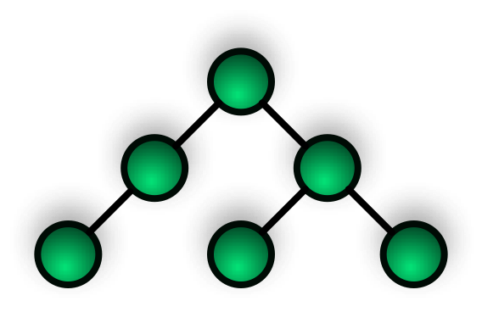
Tree Topology

Slide 54
Advantages
It is scalable.Secondary nodes allow more devices to be connected to a central node.
Point to point connection of devices.
Having different levels of the network makes it more manageable hence easier fault identification and isolation.

Slide 55
Disadvantages
Maintenance of the network may be an issue when the network spans a great area.
Since it is a variation of bus topology, if the backbone fails, the entire network is crippled.

Slide 56
Hybrid Topology
Hybrid networks use a combination of any two or more topologies in such a way that the resulting network does not exhibit one of the standard topologies (e.g., bus, star, ring, etc.).
For example, a tree network connected to a tree network is still a tree network topology. A hybrid topology is always produced when two different basic network topologies are connected. Two common examples for Hybrid network are: star ring network and star bus network.

Slide 57
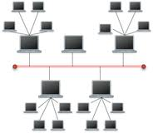
Tree Topology

Slide 58
Question 3:
What is Network Topology? What are the types of network topology? Explain with proper figure. And if you have to arrange the network, Which topology would you choose and why?

Slide 59
OSI (Open Systems Interconnection)
The OSI (Open Systems Interconnection) reference model is a conceptual model that provides a framework for understanding how communication between different computer systems and network devices occurs.
It was developed by the International Organization for Standardization (ISO) in 1984 and is composed of seven layers, each with a specific function in the communication process.

Slide 60
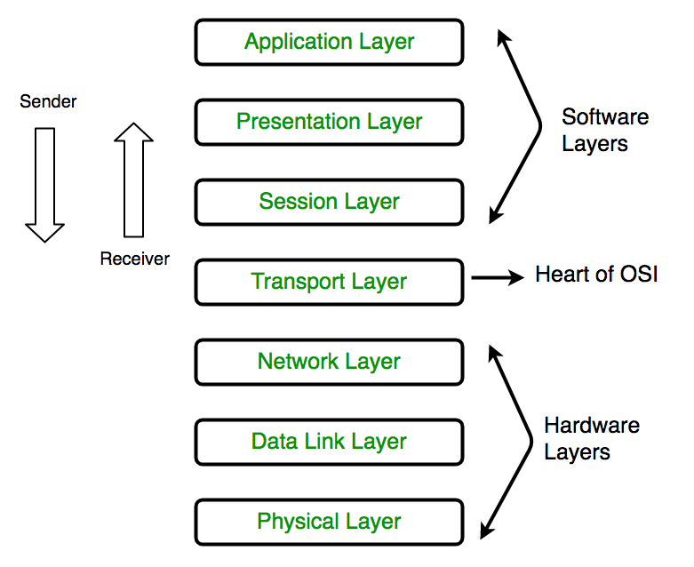
OSI (Open Systems Interconnection)

Slide 61
1. Physical Layer
Converts Binary bits of Frames into Signal to be transmitted in to media.
Cables and Connecters
Topology
Hardware
Mode of Communication

Slide 62
2. Data Link Layer
Framing
Physical Addressing
Media access control

Slide 63
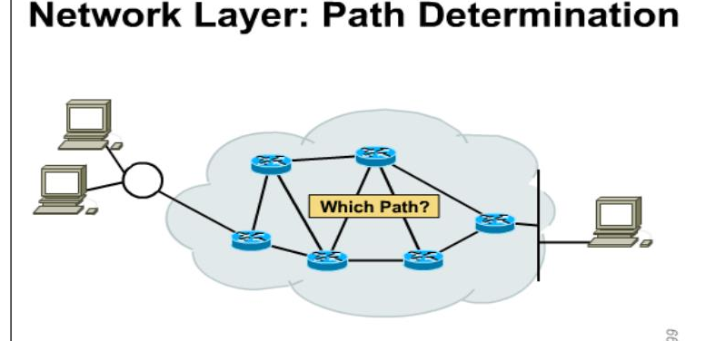
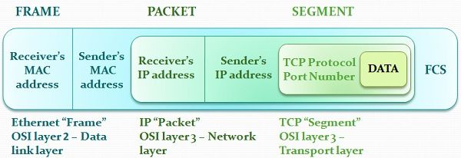
3. Network Layer
Functions of Network Layer is
Logical Addressing
Routing and Path determination

Slide 64
4. Transport Layer
This layer ensures end to end delivery of information
Ensures reliability by segmentation of information
Error control- group of bits called checksum is added to every segment
Flow control or Congestion control
Multiplexing

Slide 65
5. Session Layer
This layer establishes, manages, and terminates sessions between devices.
Authentication
Authorization
Dialog control- keeping track of whose turn it is to transmit(half duplex or full duplex)
Maintain checkpoints and recovery
Synchronization

Slide 66
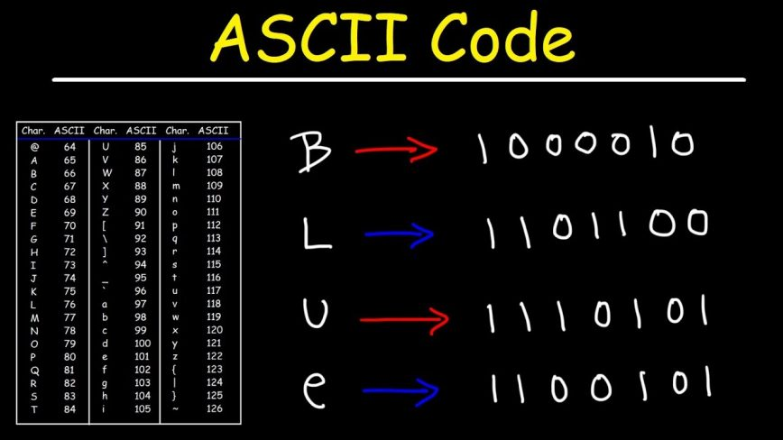
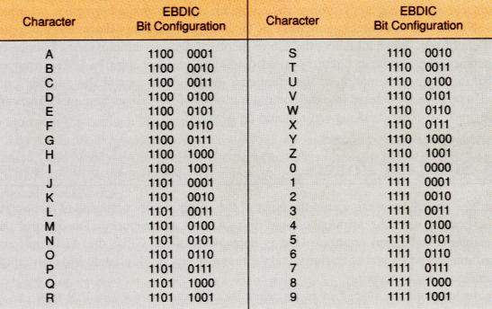
6. Presentation Layer
This layer is responsible for
Data encryption, Data compression, and data conversion between different data formats. ASCII to EBCDIC.
Concerned with syntax and semantics of the information transmitted.

Slide 67
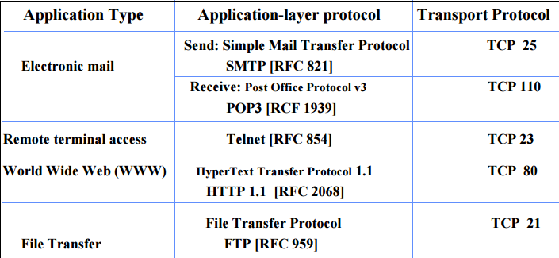
7. Application Layer
This layer provides services to applications and end-users.
It contains variety of protocols that are needed for these application

Slide 68
TCP/IP Model
This practical implementation model of computer network.
The two main protocols in the IP suite serve specific functions. TCP defines how applications can create channels of communication across a network. It also manages how a message is assembled into smaller packets before they are then transmitted over the internet and reassembled in the right order at the destination address.
IP defines how to address and route each packet to make sure it reaches the right destination. Each gateway computer on the network checks this IP address to determine where to forward the message.

Slide 69
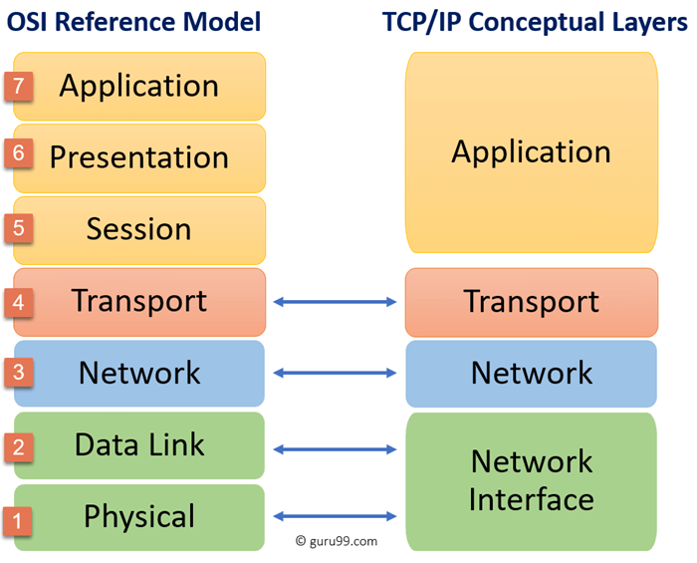
TCP/IP Model

Slide 70
Communication Protocols
Communication protocols are a set of rules and standards that govern the exchange of data and information between devices, systems, or networks. They are used to ensure that devices or systems can communicate with each other efficiently, accurately, and securely. In general, communication protocols define the format, timing, sequencing, and error-checking of messages exchanged between communicating entities.

Slide 71
Some common types of communication protocols include:
Transmission Control Protocol/Internet Protocol (TCP/IP): This is a widely used protocol for communication over the internet and is the basis of the internet's infrastructure. It provides reliable, connection-oriented communication between devices on different networks.
Hypertext Transfer Protocol (HTTP): This is a protocol used for communication between web servers and web clients. It defines how data is exchanged between web servers and clients and is used to transfer web pages and other web content.
Simple Mail Transfer Protocol (SMTP): This is a protocol used for sending and receiving email messages over the internet. It defines the format and transmission of email messages between email servers.

Slide 72
Some common types of communication protocols include:
File Transfer Protocol (FTP): This is a protocol used for transferring files between computers on a network. It allows users to upload and download files from a remote server.
User Datagram Protocol (UDP): This is a simple, connectionless protocol that does not provide the reliability of TCP/IP. It is used for streaming media, gaming, and other applications that require real-time data transfer.
Wireless Application Protocol (WAP): This is a protocol used for accessing the internet on mobile devices. It defines how data is transferred between mobile devices and the internet.

Slide 73
Centralized vs Distributed network
In computer networking, a centralized network and a decentralized network are two different ways of organizing and managing network resources, such as data, applications, and computing power.
A centralized network, also known as a client-server network, has a centralized server that is responsible for managing and controlling network resources. In this type of network, clients or end-users access the network resources through a central server. The server controls access to the network resources and manages the sharing of data and applications. Examples of centralized networks include email servers, file servers, and web servers.

Slide 74
Centralized vs Distributed network
On the other hand, a decentralized network, also known as a peer-to-peer (P2P) network, distributes the control and management of network resources across all the connected devices or nodes. In a decentralized network, each node is responsible for storing and sharing its own resources with other nodes on the network. This type of network allows for more distributed decision making, better scalability, and greater resilience against system failures. Examples of decentralized networks include BitTorrent, blockchain networks, and some file sharing networks.
Both centralized and decentralized networks have their advantages and disadvantages. Centralized networks can provide more efficient management and control of network resources, and can be easier to manage and secure. However, they may also be more vulnerable to attacks and system failures, and can be limited in terms of scalability and flexibility.

Slide 75
Networking Hardware
Networking hardware is the physical equipment used in computer networking to facilitate communication and data exchange between devices or computers. Some examples of networking hardware are:
Network Interface Cards (NICs): These are hardware components that enable computers to connect to a network. They are responsible for transmitting and receiving data between the computer and the network.
Switches: A switch is a device that connects multiple devices or computers in a network, allowing them to communicate with each other. It can route data between different devices in the network and can be used to segment a network to improve performance and security.

Slide 76
Networking Hardware
Modem: A modem is a device that connects a computer or network to the internet or other networks. It converts digital signals from a computer to analog signals that can be transmitted over telephone or cable lines.
Routers: A router is a device that connects multiple networks together, allowing devices in one network to communicate with devices in another network. It can route data between different networks, and can also provide network security by filtering and blocking unwanted traffic.
Repeaters and Range Extenders: These devices can be used to boost the signal of a wireless network, extending the range of the network and improving connectivity in areas with weak signals.

Slide 77
Wireless Networking
Wireless networking is a method of connecting devices or computers without using physical cables or wires. It is a type of computer networking that uses radio waves or infrared signals to transmit data between devices. Some common wireless networking technologies include Wi-Fi, Bluetooth, and NFC (Near Field Communication).
Wireless networking is popular in many different settings, including homes, offices, public spaces, and transportation systems.

Slide 78
Advantages:
Some advantages of wireless networking include:
Mobility: Wireless networking allows devices to connect and communicate with each other without being physically connected. This makes it easy to move devices around and connect to the network from different locations.
Convenience: Wireless networking eliminates the need for messy cables and wires, making it easier to set up and use.
Scalability: Wireless networks can be easily expanded and upgraded by adding new devices or access points, allowing them to grow as the network needs expand.
Cost-effective: Wireless networking can be more cost-effective than wired networking, especially in situations where a wired network is difficult or expensive to install.

Slide 79
Disadvantages:
However, wireless networking also has some disadvantages, such as:
Security: Wireless networks can be more vulnerable to security threats, such as hacking or eavesdropping, than wired networks. Proper security measures such as encryption and secure authentication are necessary to keep wireless networks secure.
Interference: Wireless networks can be affected by interference from other wireless devices or physical obstacles such as walls or buildings. This can lead to reduced performance or signal loss.
Performance: Wireless networks may have lower performance or speed compared to wired networks, especially in situations where many devices are connected to the network or the network is located in an area with a lot of interference.
Overall, wireless networking can be a convenient and flexible way to connect devices and computers in a variety of settings, but it's important to be aware of the potential security and performance issues associated with wireless networks.

Slide 80
Question
What is communication protocols? Explain any 5 communication protocols?
What is centralized and decentralized network? What kind of hardware we used in networking?

